Slide 1

MOSCOW MIDDLE SCHOOL
Pre-Bond Conceptual Package

Slide 2
Our Process.
WHERE WE’RE AT

Slide 3
Listen
Align
Design
Coordinate
Deliver
Our Process
Our Approach
TRIED AND TRUE.
Understanding
people and
purpose
Defining
Vision &
priorities
Transforming vision into concepts

Slide 4
Listen
Align
Design
Coordinate
Deliver
Our Process
Our Approach
TRIED AND TRUE.
*NOT TO SCALE
At this point, the project is clearly defined and visualized, positioning MSD to rally community support.

Slide 5
We listened.
DISCOVERY TACTICS

Slide 6
WHO WE LISTENED TO AND HOW
WHO we listened to:
School District Leadership
Middle School Leadership
Faculty & Staff
Trustees
Students
HOW we listened:
8 Group Meetings (In-person and virtual)
Staff Survey
Facility Tour
Site Visits

Slide 7
The Big Takeaway
The district wants to create a next-generation learning environment that better reflects how middle school students learn, collaborate, create, and connect today.

Slide 8
Across nearly every response, current school culture was described as:
Highly collaborative
Relationship-driven
Creative and student-centered
Community-connected
Flexible and resourceful
At the same time, the current facility was consistently described as:
Difficult to secure / operationally fragmented
Acoustically challenging
Lacking specialized support spaces
Inflexible for evolving programming
Not fully aligned with contemporary teaching models

Slide 9
We aligned.
SUCCESS THEMES + VISION
PROGRAM + ADJACENCIES

Slide 10
Success Themes
Rooted in
Community
Flexible +
Future-Ready Education
Student
Belonging +
Wellbeing
Creativity
+ Exploration
Operational
Clarity +
Security
The project is successful if . . .
the school feels distinctly rooted in Moscow’s culture, values, creativity, and outdoor spirit while creating meaningful connections between students, staff, families, and the broader community.
The project is
successful if . . .
spaces can evolve alongside changing teaching methods, technology, and student needs.
The project is successful if . . .
students feel emotionally safe, supported, connected, and able to thrive.
The project is
successful if . . .
the building actively supports hands-on learning, innovation, performance, making, and discovery.
The project is successful if . . .
the school is easy to supervise, easy to maintain, secure without feeling restrictive, and supportive of both school-day and after-hours use.
Notes:
Safety + Dignity = Experience Operational + Staff = Performance Flexibility = Future

Slide 11
Core Objectives
Rooted in
Community
Flexible +
Future-Ready Education
Student
Belonging +
Wellbeing
Creativity
+ Exploration
Operational
Clarity +
Security
Strong indoor/outdoor connections
Community-accessible gathering spaces
Flexible commons for events and shared use
Design reflecting Moscow’s culture and outdoor identity
Spaces that encourage collaboration and relationship-building
Welcoming arrival experience reinforcing school identity
Notes:
Safety + Dignity = Experience Operational + Staff = Performance Flexibility = Future

Slide 12
Core Objectives
Rooted in
Community
Flexible +
Future-Ready Education
Student
Belonging +
Wellbeing
Creativity
+ Exploration
Operational
Clarity +
Security
Adaptable classroom environments
Flexible small-group breakout spaces
Shared interdisciplinary learning zones
Infrastructure expansion capacity
Flexible technology integration
Multi-use instructional spaces
Notes:
Safety + Dignity = Experience Operational + Staff = Performance Flexibility = Future

Slide 13
Core Objectives
Rooted in
Community
Flexible +
Future-Ready Education
Student
Belonging +
Wellbeing
Creativity
+ Exploration
Operational
Clarity +
Security
Wellness and emotional regulation spaces
Counseling spaces with privacy and acoustic separation
Quiet decompression environments
Natural light throughout primary learning spaces
Comfortable student gathering areas
Inclusive and intuitive wayfinding
Notes:
Safety + Dignity = Experience Operational + Staff = Performance Flexibility = Future

Slide 14
Core Objectives
Rooted in
Community
Flexible +
Future-Ready Education
Student
Belonging +
Wellbeing
Creativity
+ Exploration
Operational
Clarity +
Security
Expanded makerspaces and hands-on learning labs
Podcast/media production environments
Robust CTE and applied learning space
Flexible project-based learning environments
Performing arts support spaces
Visible opportunities for student work and innovation
Notes:
Safety + Dignity = Experience Operational + Staff = Performance Flexibility = Future

Slide 15
Core Objectives
Rooted in
Community
Flexible +
Future-Ready Education
Student
Belonging +
Wellbeing
Creativity
+ Exploration
Operational
Clarity +
Security
Reduced and controlled access points
Zoned after-hours community circulation
Clear visitor management strategies
Safe and efficient parent drop-off/pick-up
Passive supervision through visibility and circulation
Durable, maintainable materials and systems
Notes:
Safety + Dignity = Experience Operational + Staff = Performance Flexibility = Future

Slide 16
Vision
Statement
A safe, adaptable, and supportive school environment that is rooted in Moscow values and empowers every student to belong, connect, and explore.

Slide 17
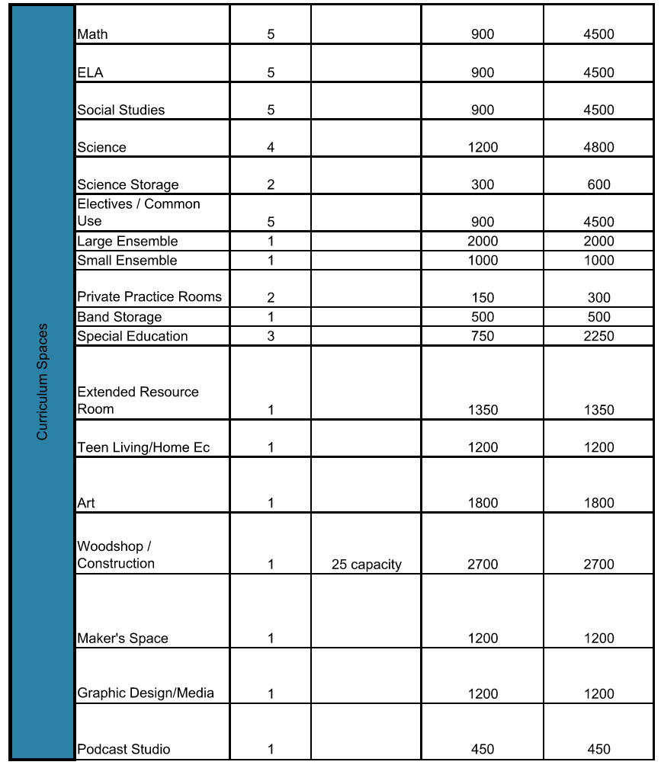
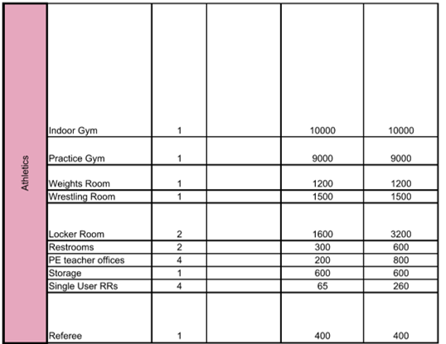
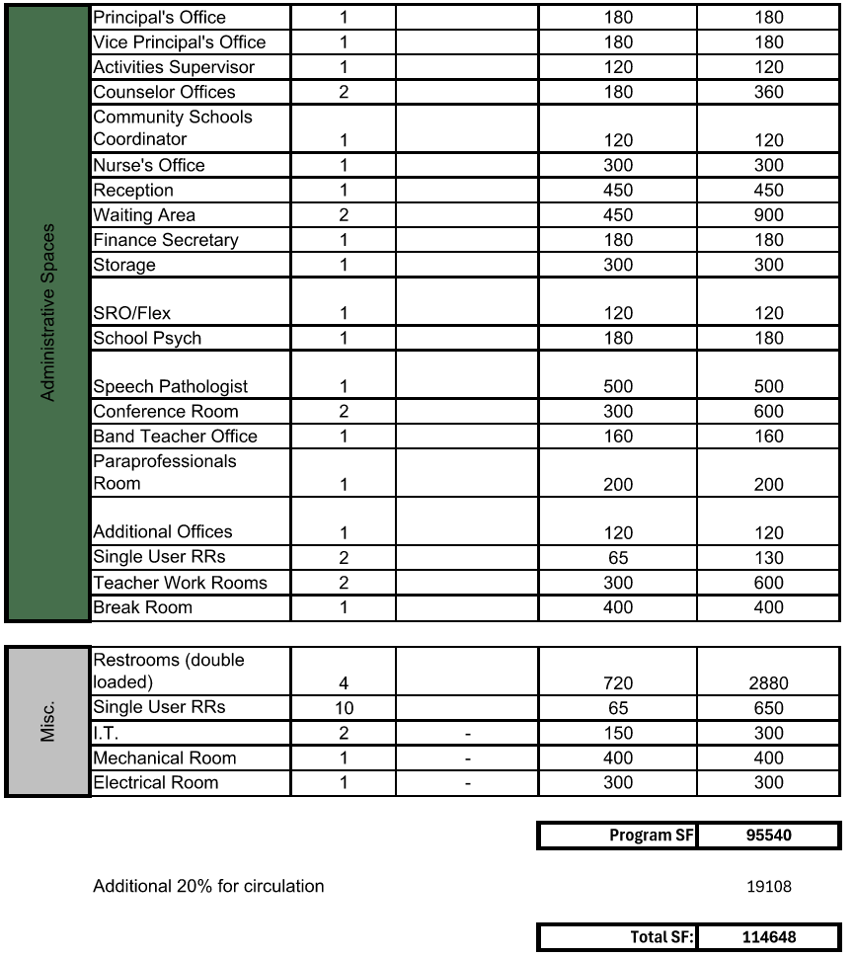
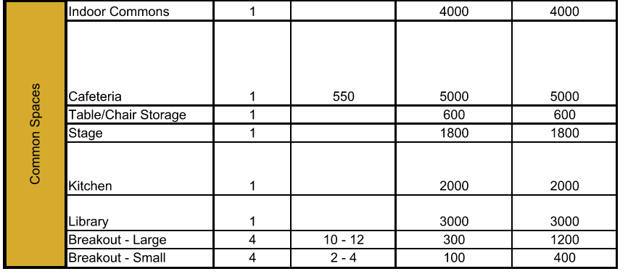
PROGRAM SPACES by DEPARTMENT
Curriculum Spaces
Common Spaces
Athletics
Administrative Spaces
Building Support

Slide 18
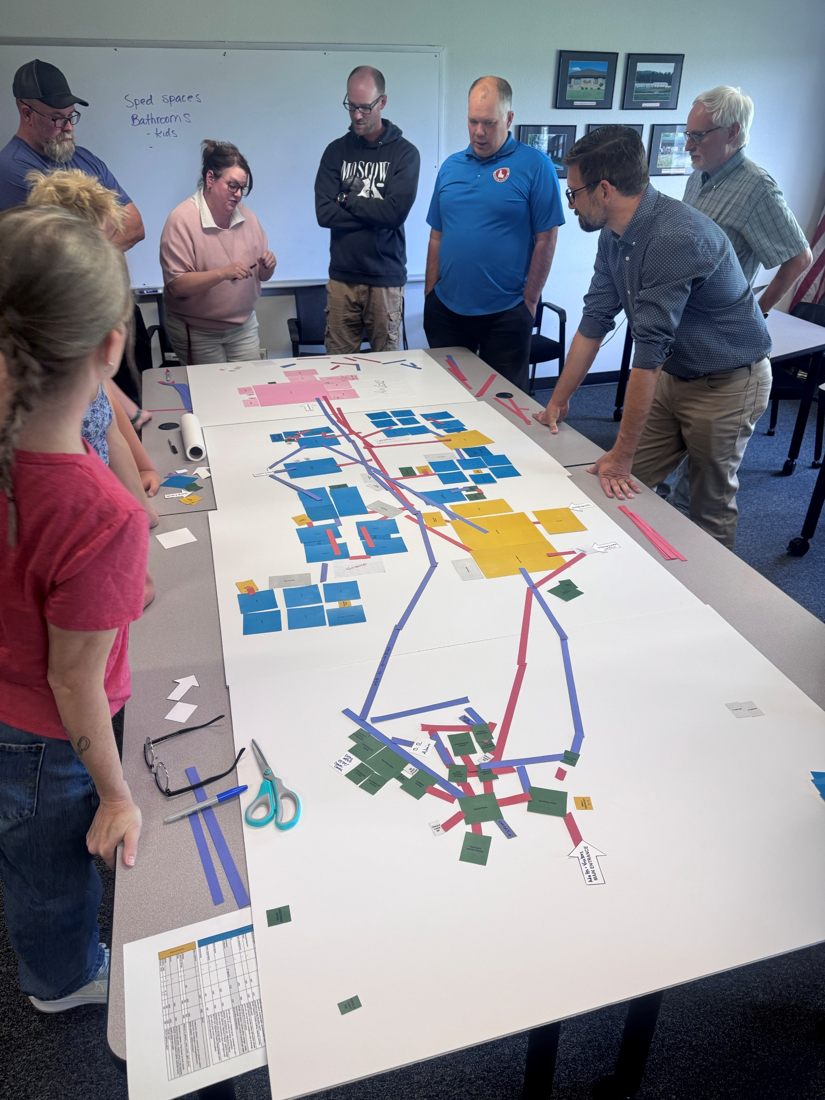
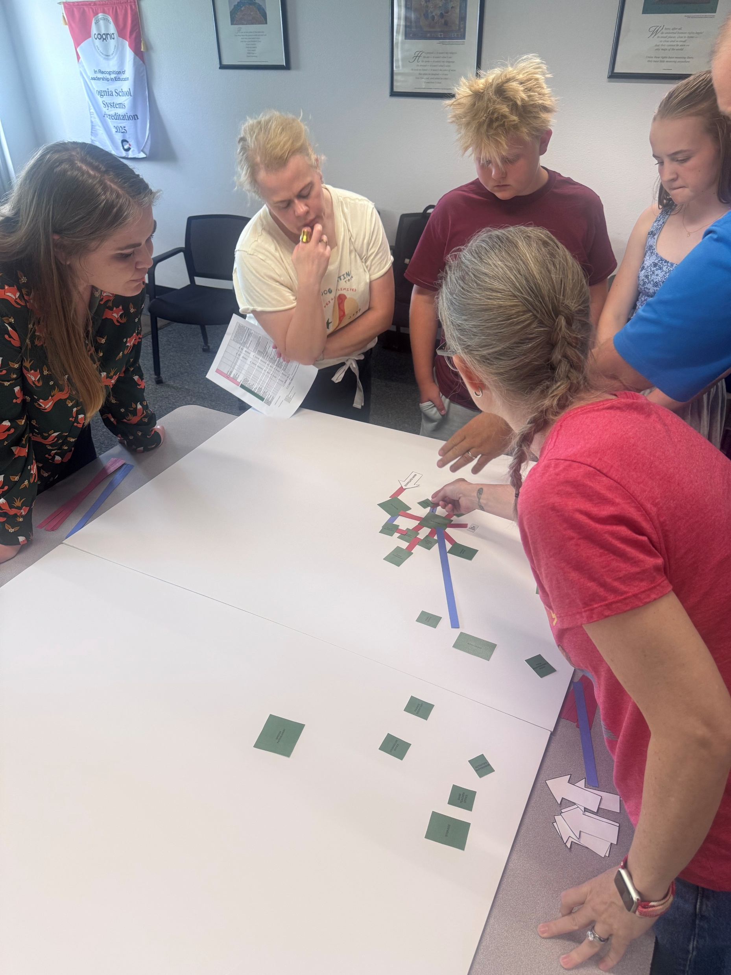
Our Approach
TRIED AND TRUE.
ALIGNMENT MAPPING

Slide 19
We got to work.
FLOOR PLAN + MASSING + CONCEPT

Slide 20
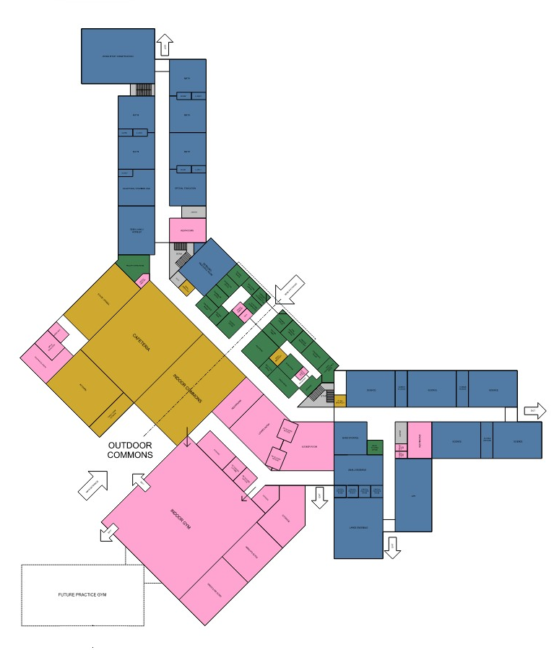
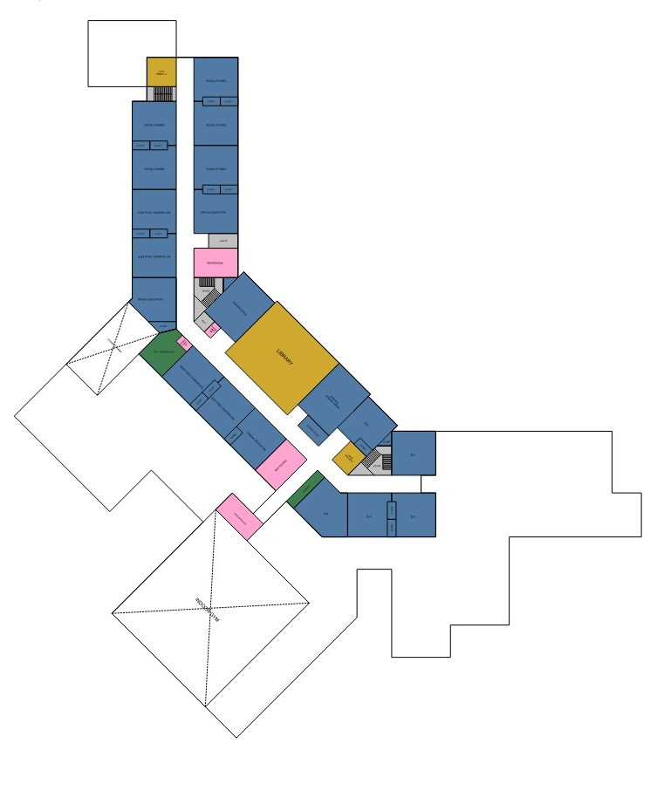

CONCEPT PLANS
Curriculum Spaces
Common Spaces
Athletics
Administrative Spaces
Building Support
1ST FLOOR
2ND FLOOR

Slide 21
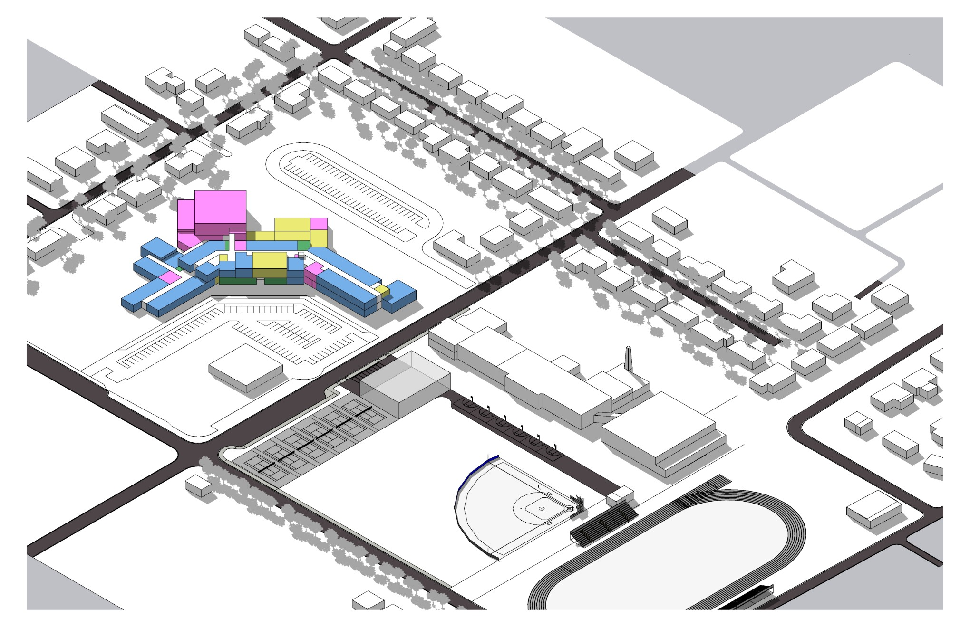
CONCEPT MASSING
Curriculum Spaces
Common Spaces
Athletics
Administrative Spaces
Building Support

Slide 22
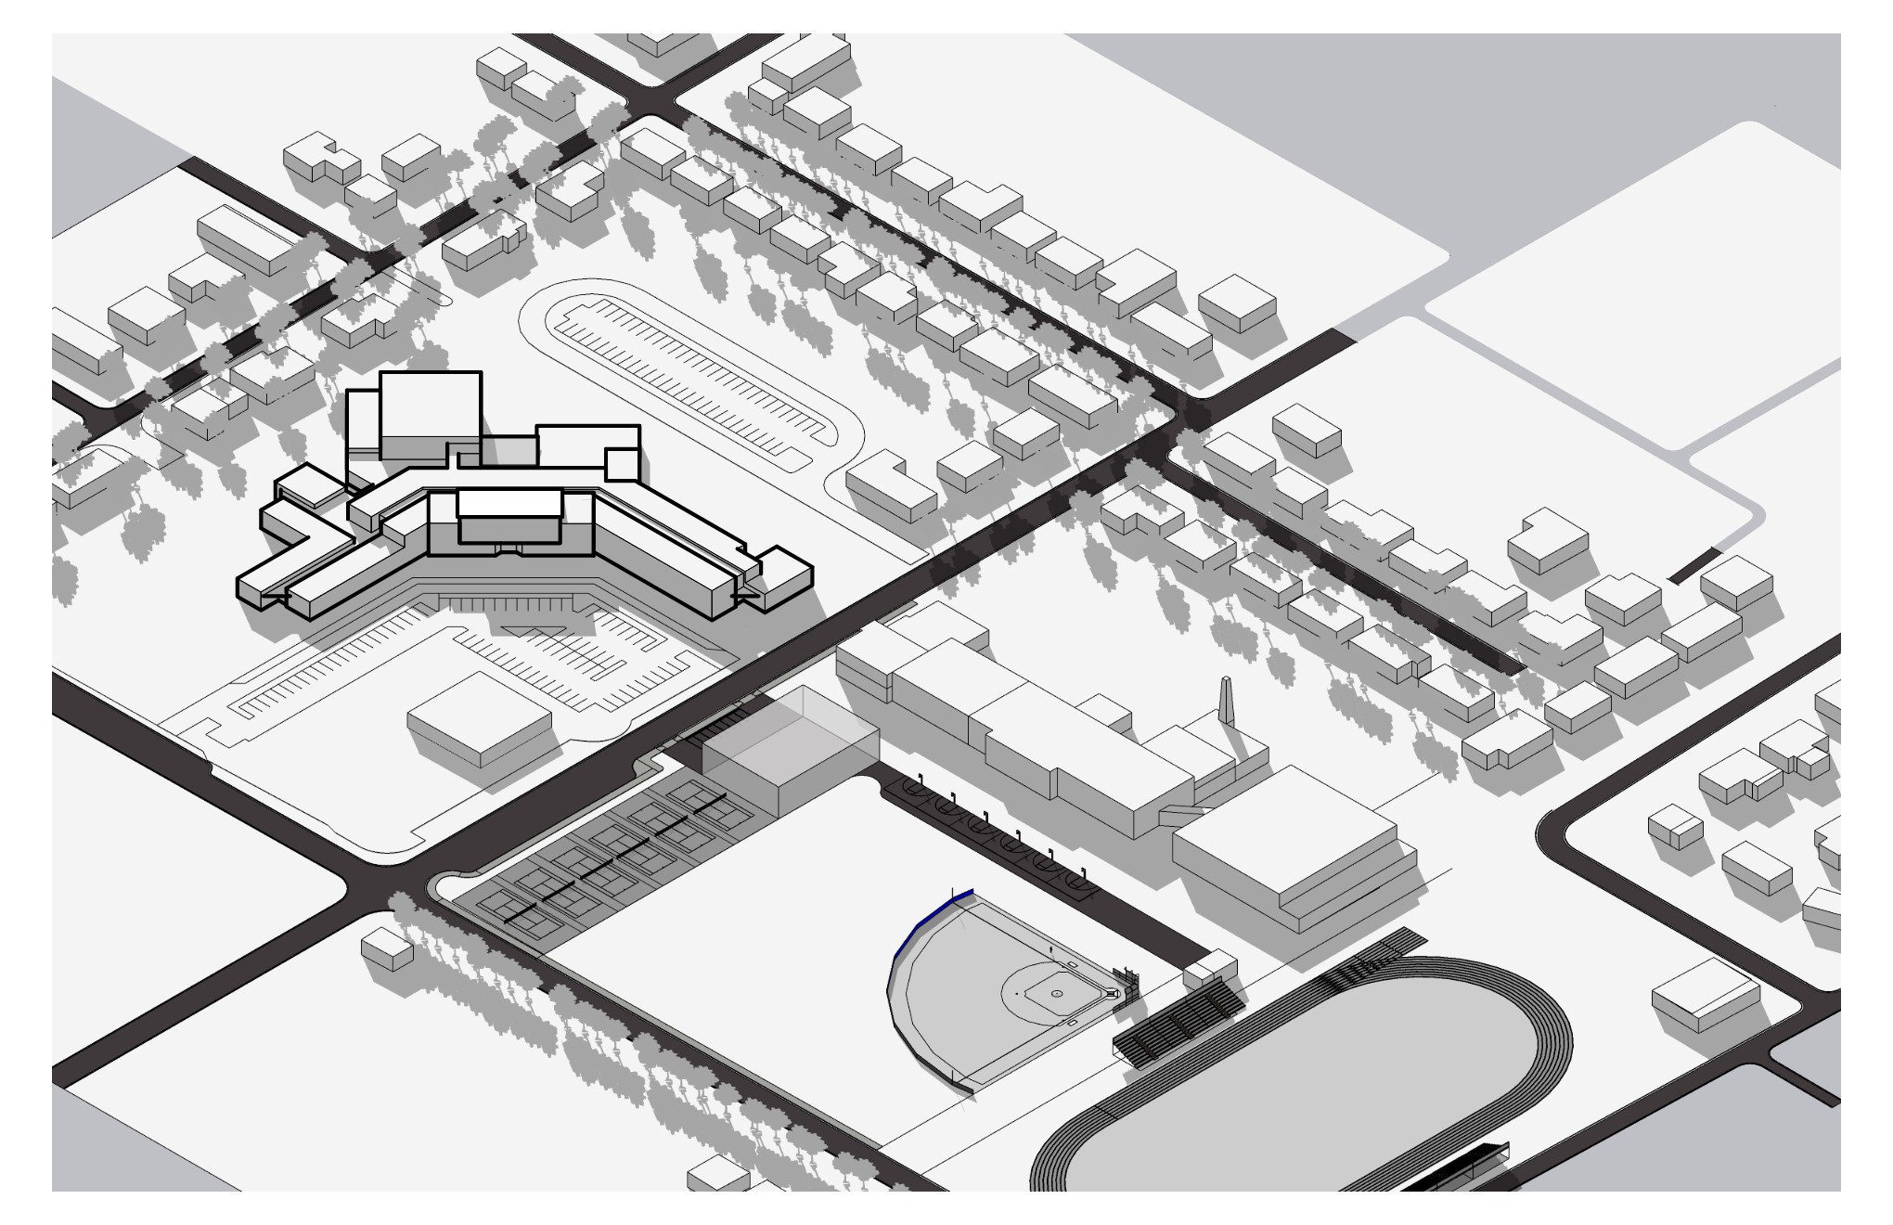
CONCEPT MASSING

Slide 23
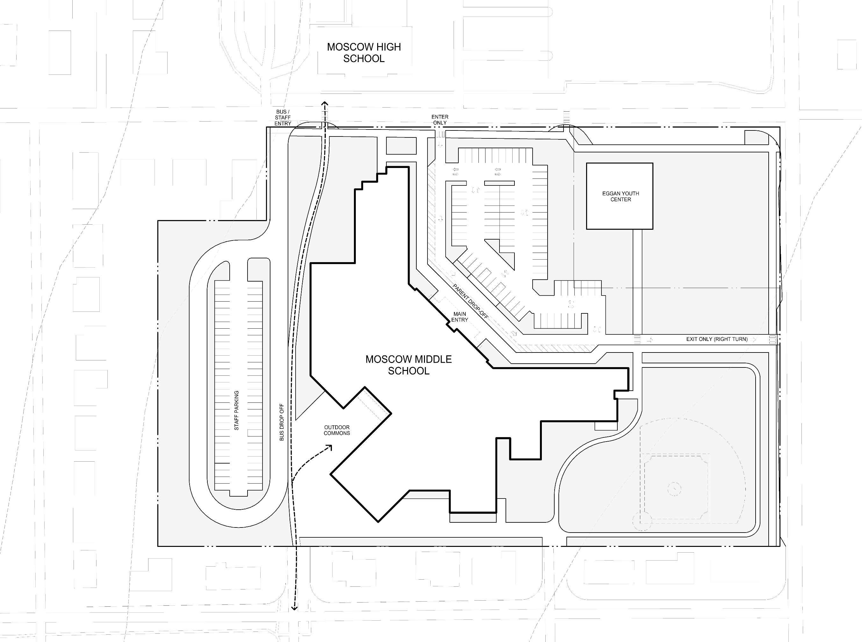
Our Approach
TRIED AND TRUE.
D STREET
SITE PLAN
N. MOUNTAIN VIEW ROAD
B STREET

Slide 24
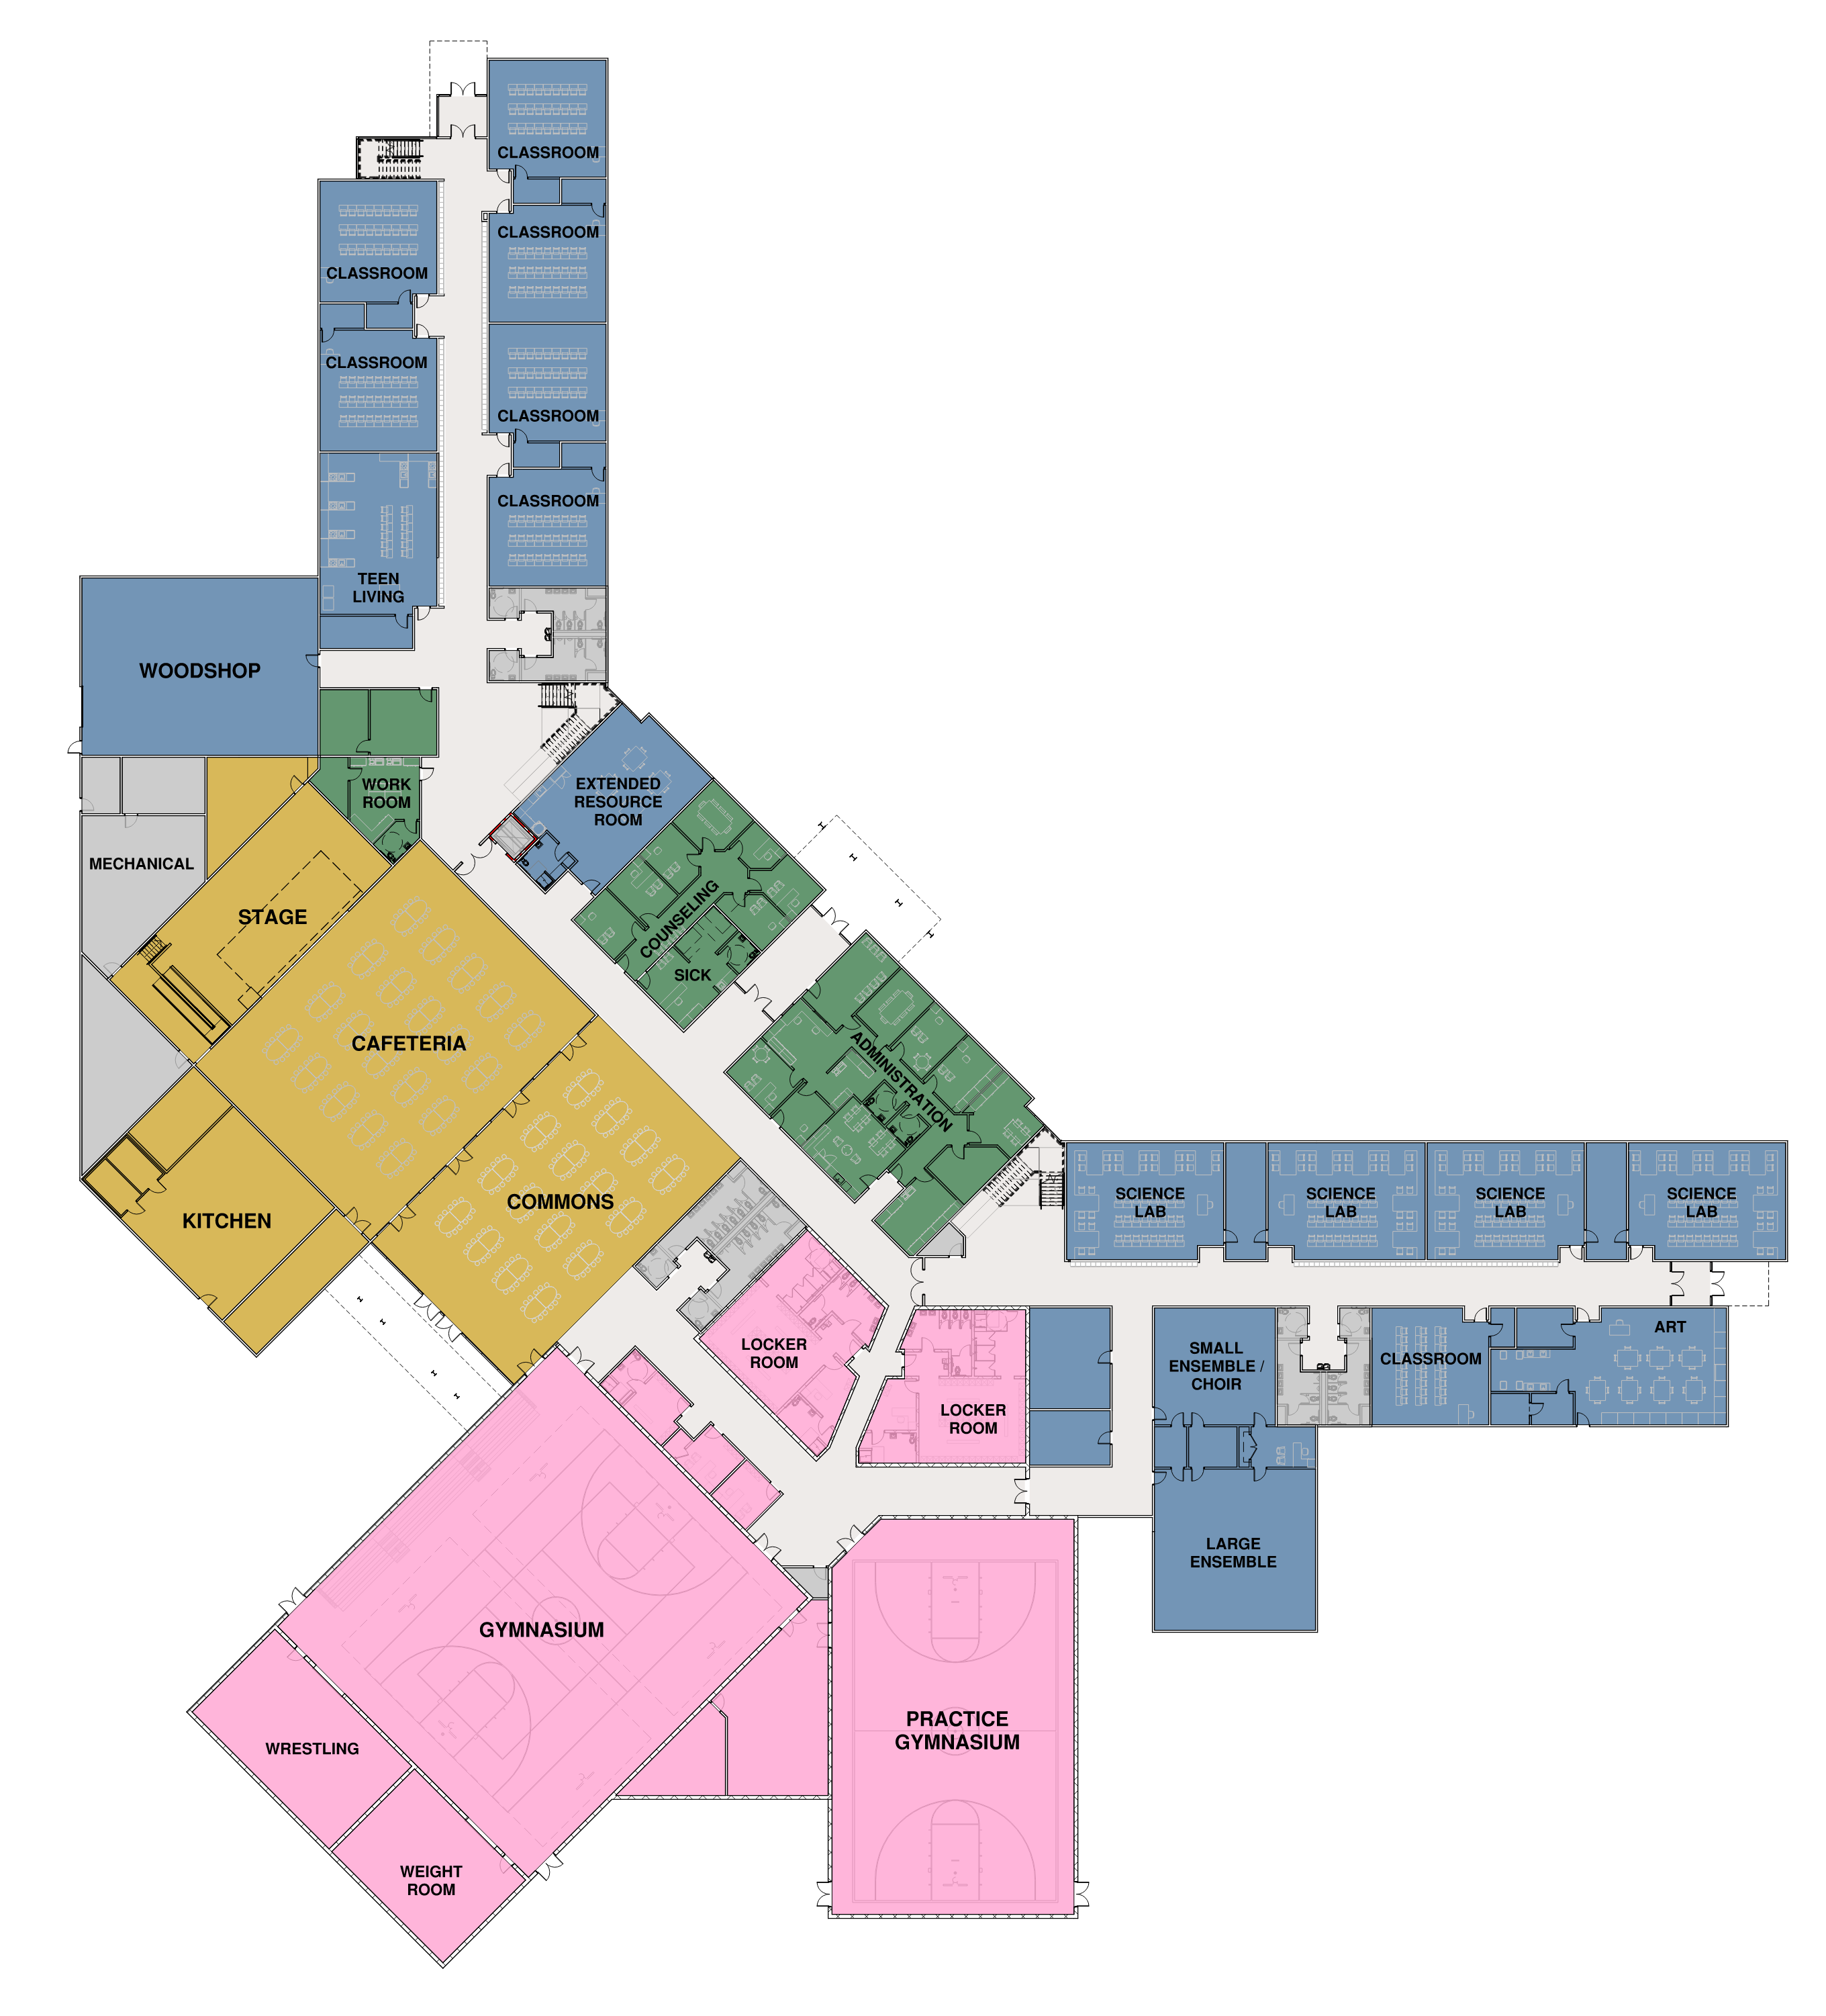
Our Approach
TRIED AND TRUE.
FLOOR PLANS:
FIRST FLOOR
Curriculum Spaces
Common Spaces
Athletics
Administrative Spaces
Building Support

Slide 25
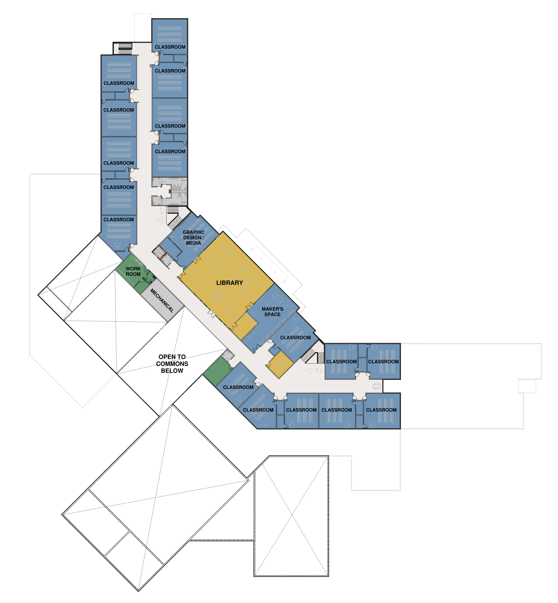
FLOOR PLANS:
SECOND FLOOR
Curriculum Spaces
Common Spaces
Athletics
Administrative Spaces
Building Support

Slide 26
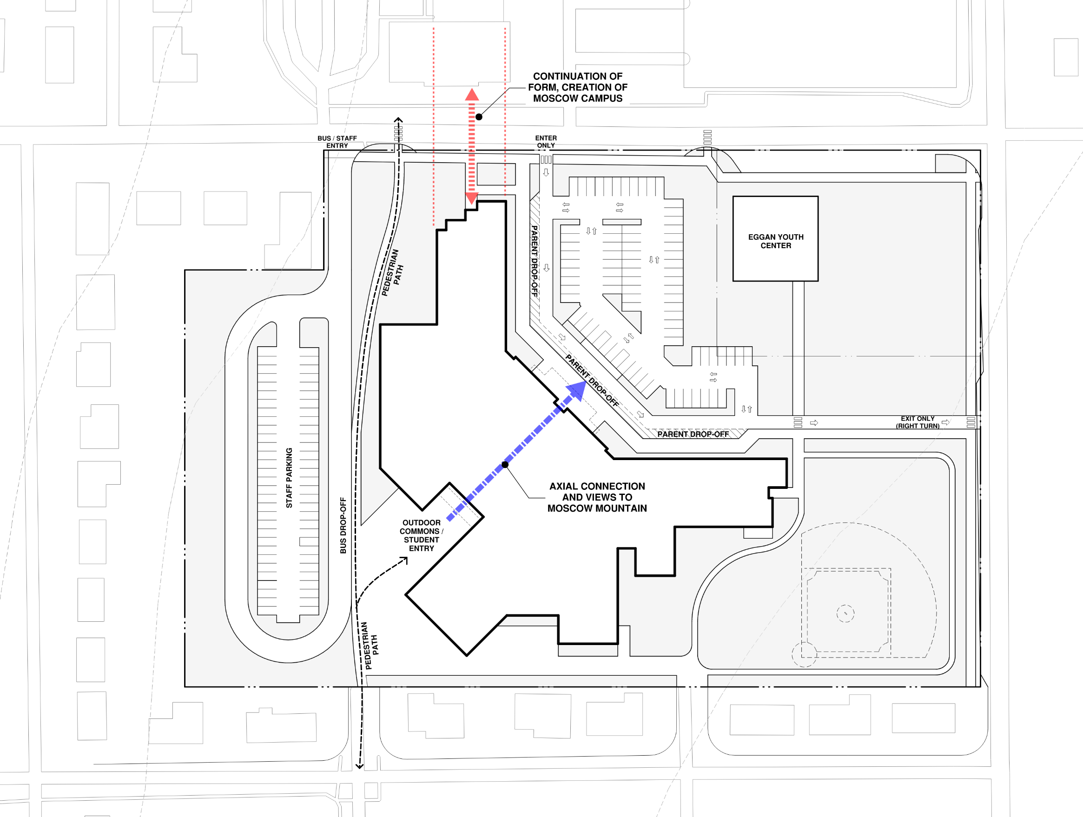
ROOTED IN COMMUNITY
Strong indoor/outdoor connections
Welcoming arrival experience reinforcing school identity

Slide 27
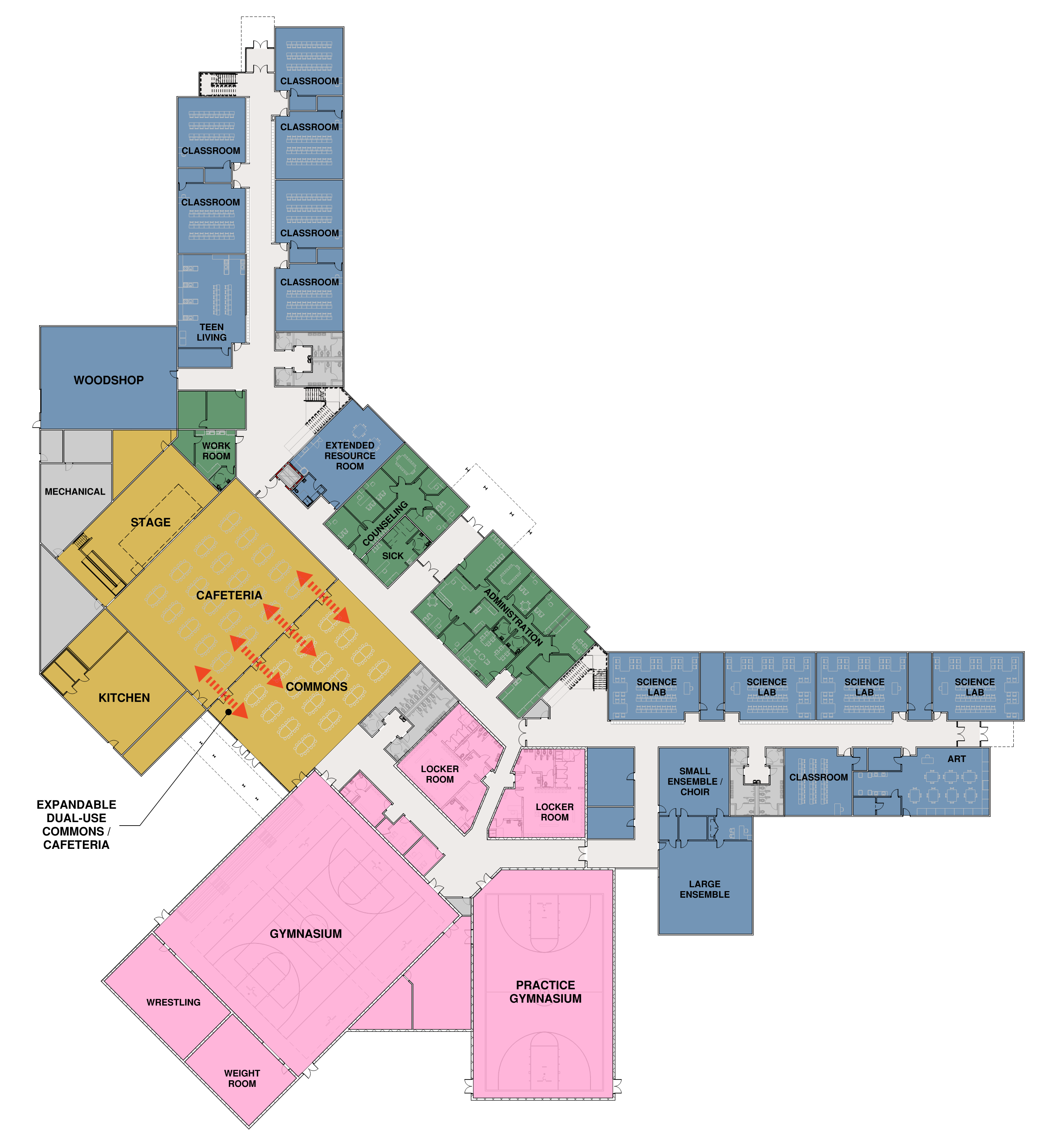
FLEXIBLE & FUTURE READY
Adaptable classroom environments
Flexible small-group breakout spaces
Shared interdisciplinary learning zones

Slide 28

FLEXIBLE & FUTURE READY
Adaptable classroom environments
Flexible small-group breakout spaces
Infrastructure expansion capacity
Multi-use instructional spaces

Slide 29

STUDENT BELONGING & WELLBEING
Counseling and decompression spaces with privacy and acoustic separation
Natural light throughout primary learning spaces
Comfortable student gathering areas
Inclusive and intuitive wayfinding

Slide 30
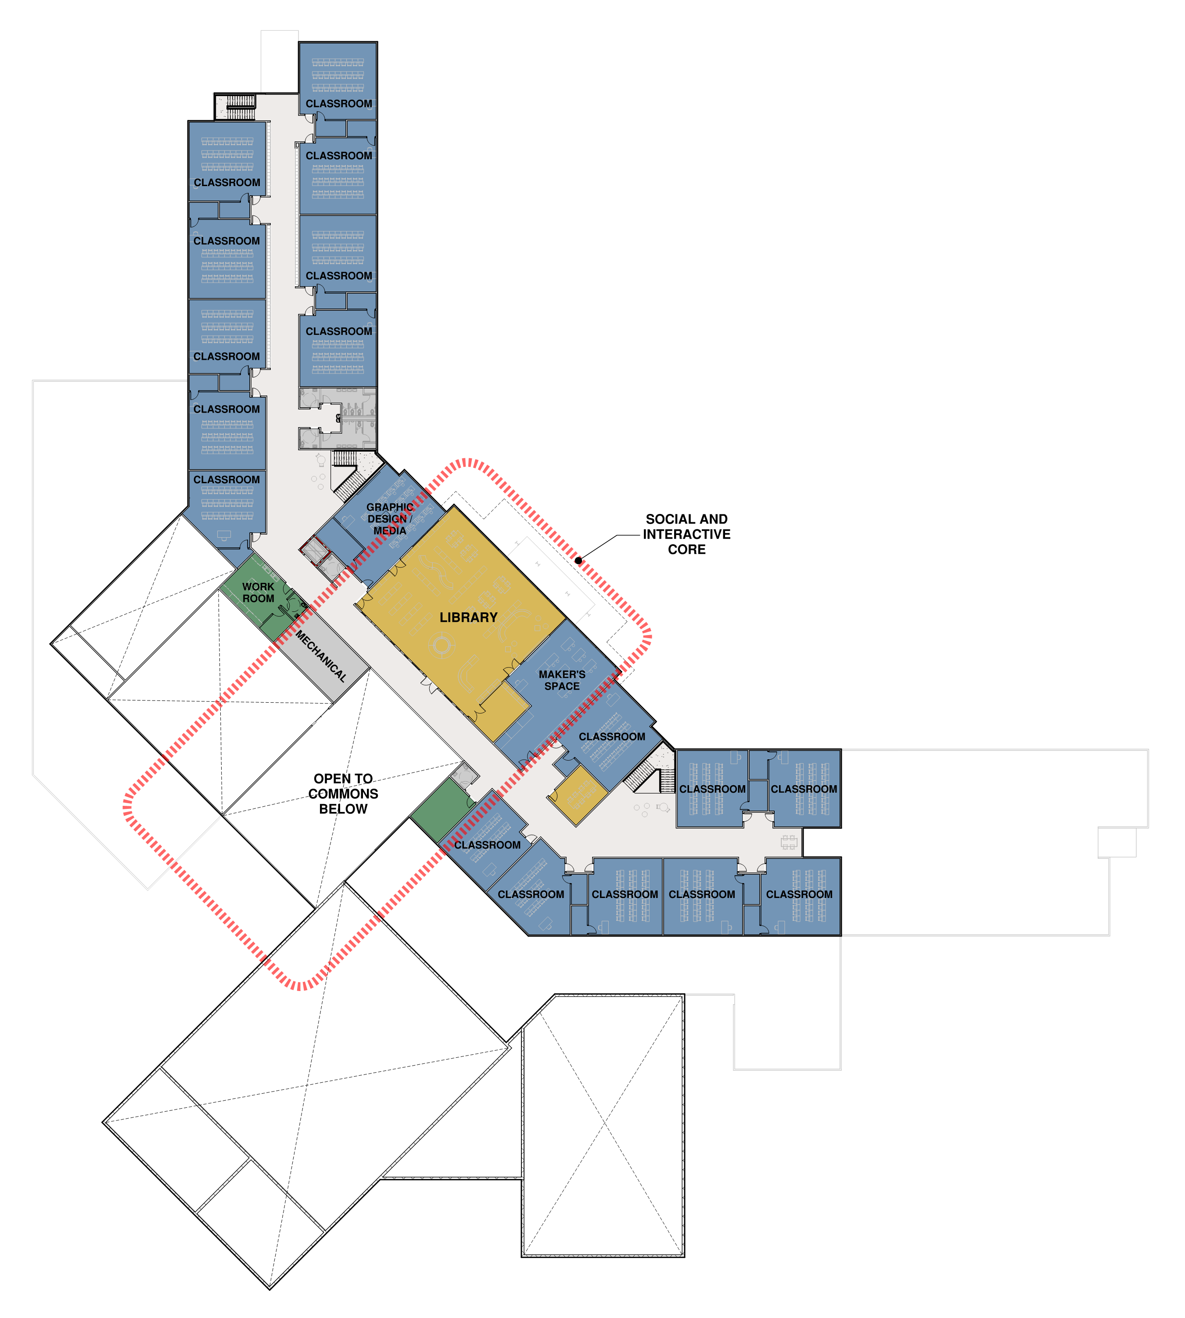
STUDENT BELONGING & WELLBEING
Natural light throughout primary learning spaces
Comfortable student gathering areas
Inclusive and intuitive wayfinding

Slide 31

CREATIVITY & EXPLORATION
Expanded makerspaces and hands-on learning labs
Robust CTE and applied learning space
Performing arts support spaces

Slide 32

CREATIVITY & EXPLORATION
Expanded makerspaces and hands-on learning labs
Podcast/media production environments
Robust CTE and applied learning space
Flexible project-based learning environments

Slide 33
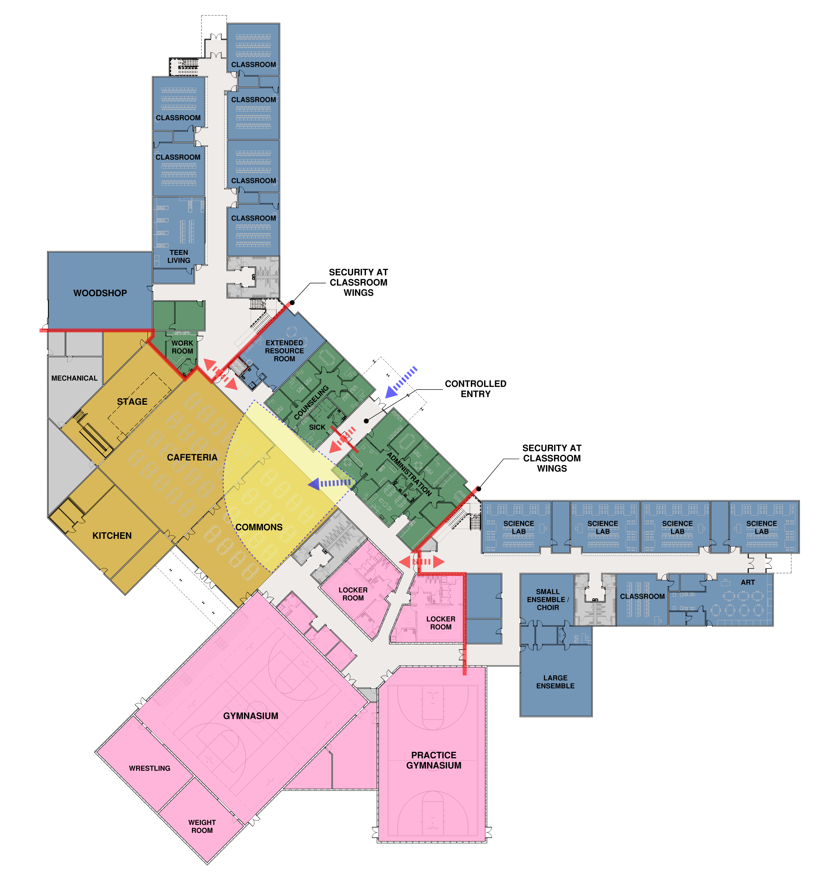
OPERATIONAL CLARITY & SECURITY
Reduced and controlled access points
Zoned after-hours community circulation
Clear visitor management strategies
Passive supervision through visibility and circulation

Slide 34
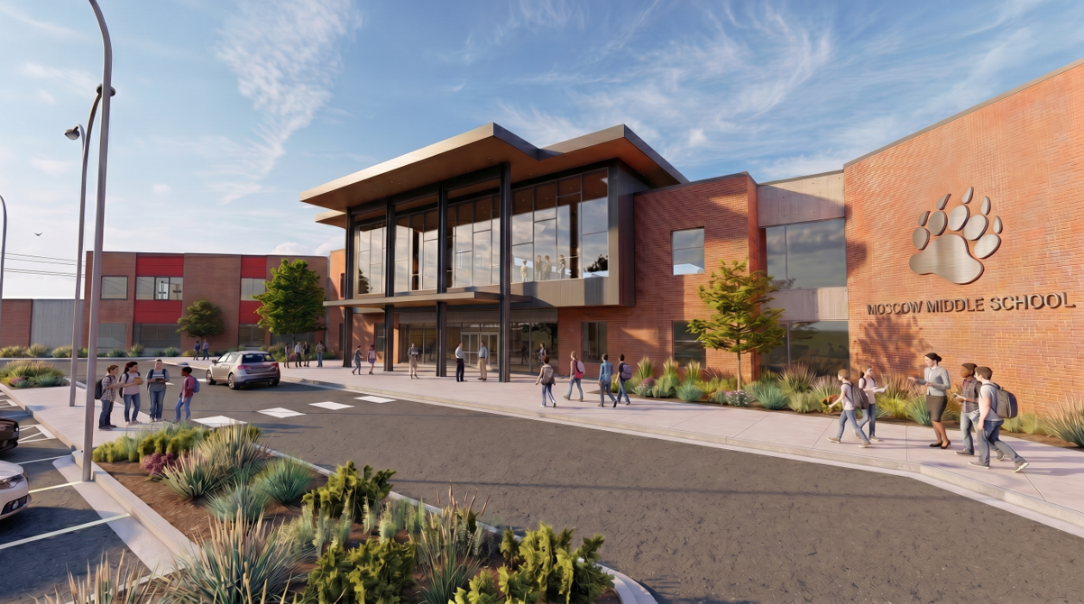
FRONT ENRTY

Slide 35
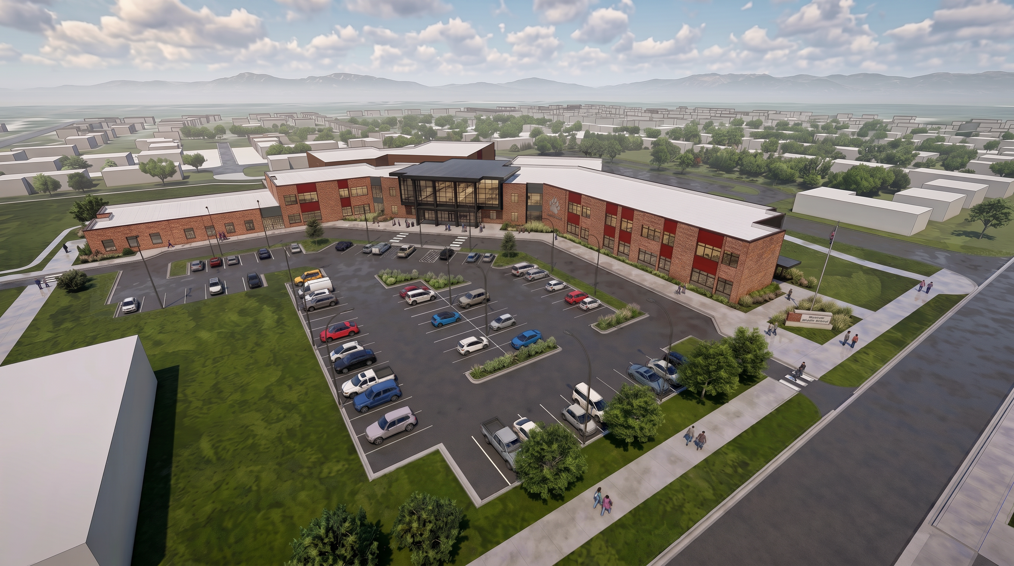
BIRDS EYE

Slide 36
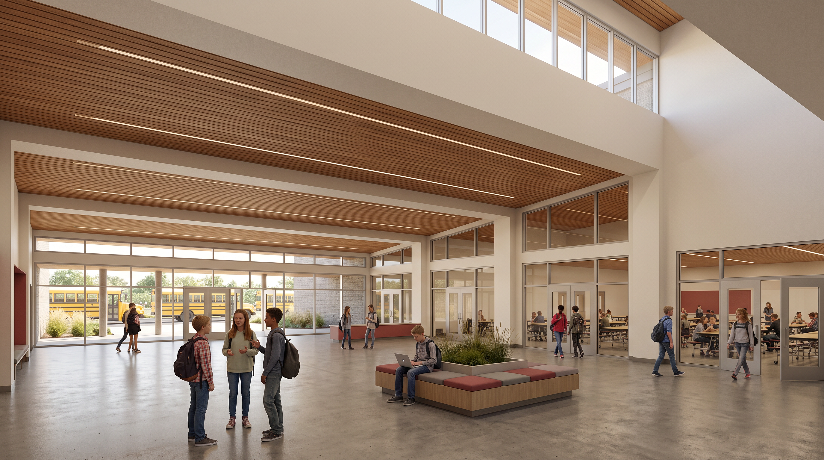
COMMONS AND LUNCHROOM

Slide 37
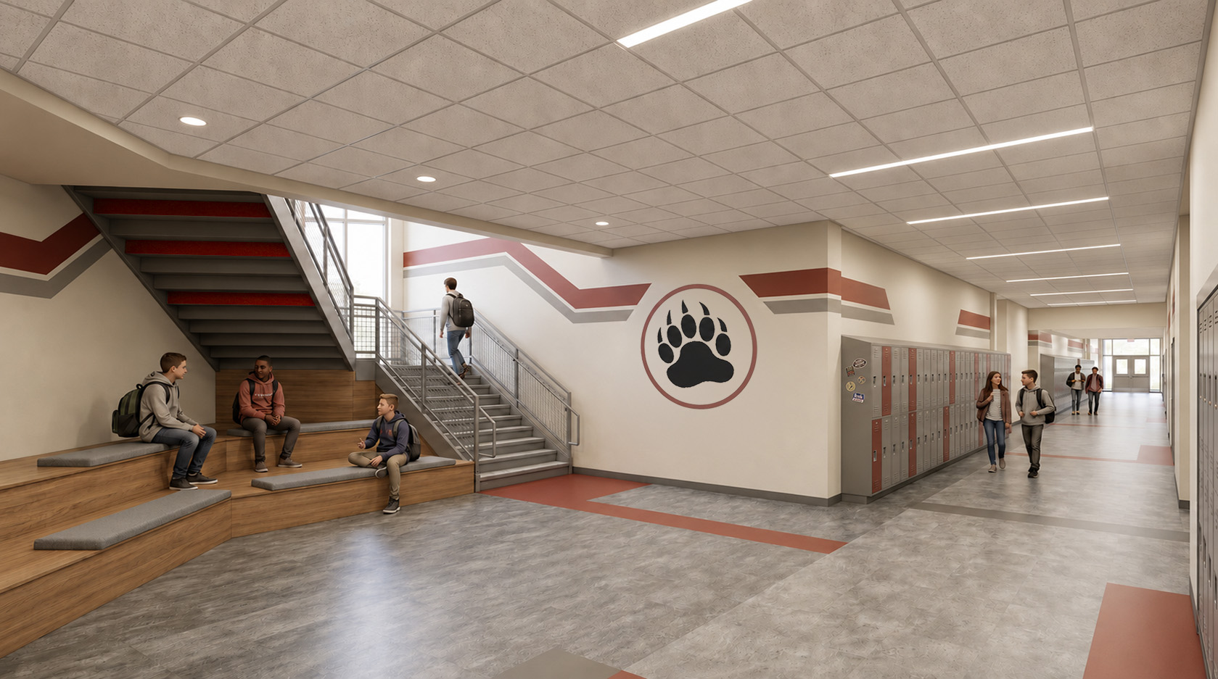
MAIN STAIRWELL

Slide 38
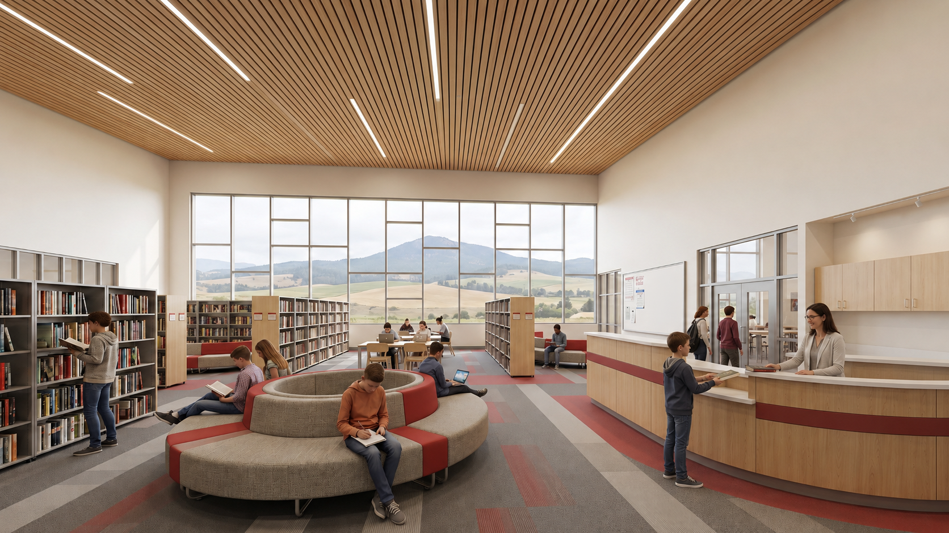
LIBRARY

Slide 39
New Building and Site
Contractor General Conditions and Profit
Subtotal: $8,436,100.00
Escalation
Starting Date: Jul-26
Total Building / General Conditions Costs: $53,156,600.00
Total W/ Escalation: 12 months @ 0.52% /mo = $56,570,100.00
Permit/Bid Submittal: Jul-27
Agency Funds
Subtotal: $2,928,600.00
Soft Costs
Subtotal: $8,024,700.00
Project Total $67,523,300.00
CONCEPTUAL COST ESTIMATE
Item | Takeoff Quantity | Total Cost / Unit | Total Amount
Building (Div 3-28) | 94,311 sqft | $409.00 /sqft | $38,573,200.00
Gymnasium Spaces | 19,316 sqft | $87.00 /sqft | $1,680,600.00
Div 02 Sitework | 10.25 Acres (446,575 sf) | $10.00 /sqft | $4,468,800.00
Subtotal |  |  | $44,720,600.00
Based on recent projects
Includes Contingency Amounts

Slide 40
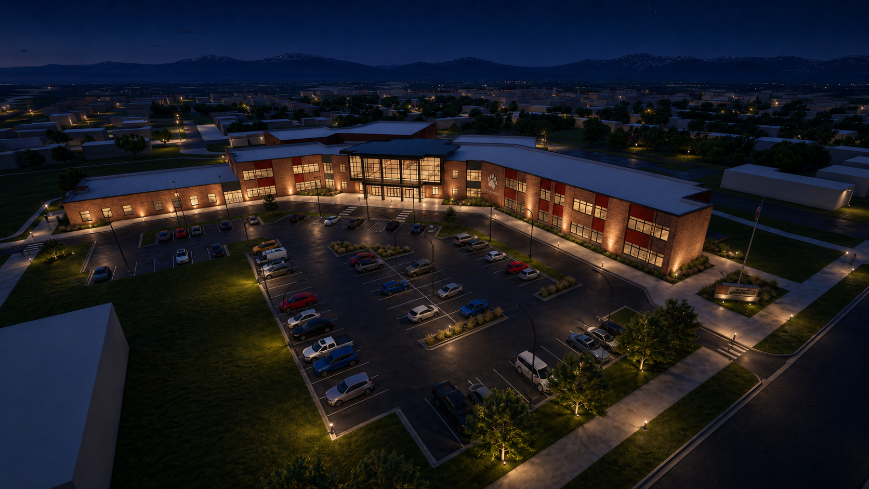
Thank you!

